Slide 1
CREATING SERVER FOR BACKEND
SALMAN AHMED G

Slide 2
CREATING DEMO SERVER
Create new folder and provide name called “server”
Inside this server open CMD and type “npm init –y”
In same CMD run “npm install -g json-server”
Create db.json file

Slide 3
Inside the db.json
{
"posts": [
{ "id": 1, "title": "json-server", "author": "typicode" }
],
"comments": [
{ "id": 1, "body": "some comment", "postId": 1 }
],
"profile": { "name": "typicode" }
}

Slide 4
How to run server
Inside the CMD in the same folder run this command “json-server --watch db.json”
Inside the postman inside the GET method
http://localhost:3000/posts

Slide 5
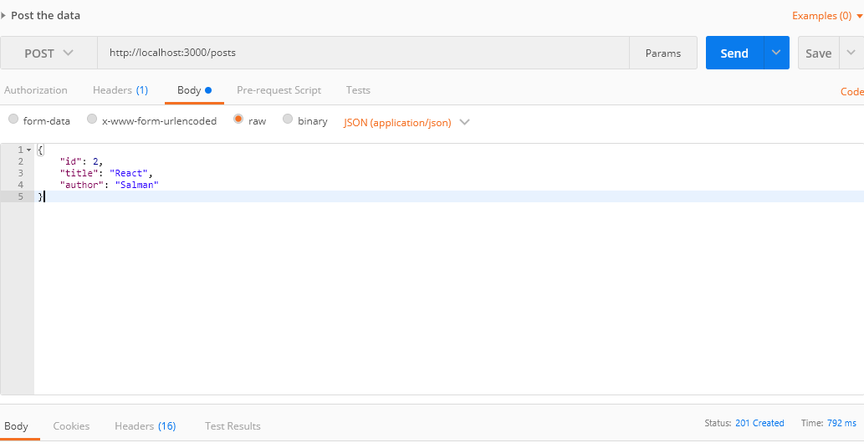
Post method

Slide 6
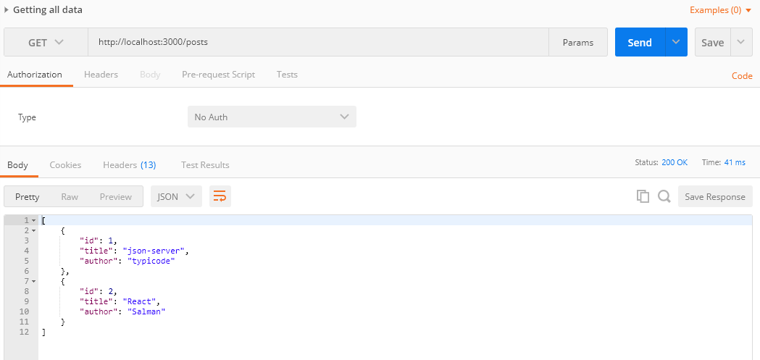
Get method – all data

Slide 7
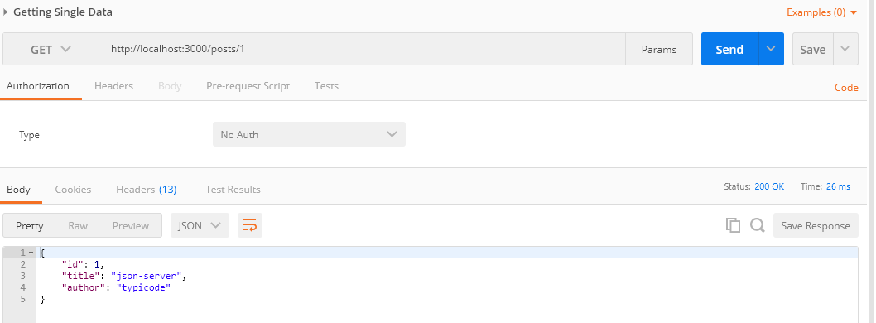
Get method – with single data

Slide 8
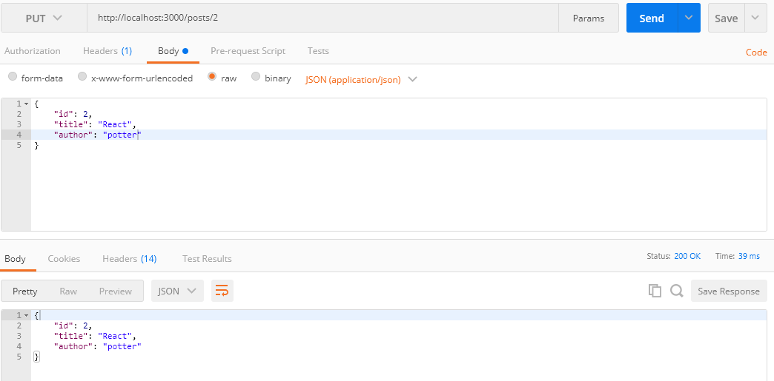
Put method

Slide 9
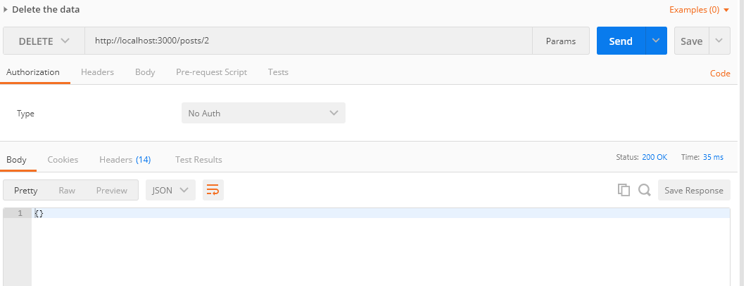
Delete method

Slide 10
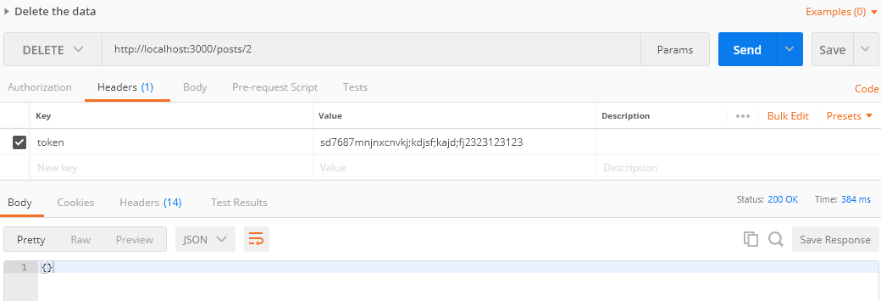
Passing data in header

